Slide 1
Python September 10, 2019

Slide 2
Data Structures
Dictionaries
Dictionaries are very similar to arrays (and lists)
A dictionary is a collection, which is unordered, changeable and indexed
In Python, dictionaries are written with curly brackets, and they have keys and values, i.e. “key: value pairs”
Dictionaries can also be iterated over in a very simple manner
Dictionaries can contain nested dictionaries
Examples of how to create dictionaries:
thisdict = { x = (“brand”, “model”, “year”)
"brand": "Ford", y = 0
"model": "Mustang", thisdict = dict.fromkeys(x, y)
"year": 1964 thisdict[“brand”] = “Ford”
} thisdict[“model”] = “Mustang”
thisdict[“year”] = 1964

Slide 3
Dictionaries
thisdict = {"brand": "Ford”, "model": "Mustang”,"year": 1964}
Accessing Items in a Dictionary
You can access the items of a dictionary by referring to its key name, inside square brackets:
x = thisdict["model"]
There is also a method called get() that will give you the same result:
x = thisdict.get("model”)

Slide 4
Dictionaries
thisdict = {"brand": "Ford”, "model": "Mustang”,"year": 1964}
You can change the value of a specific item by referring to its key name:
thisdict["year"] = 2018 change 1964 to 2018
To determine if a specified key is present in a dictionary use the in keyword:
if "model" in thisdict:
print("Yes, 'model' is one of the keys in the thisdict dictionary")
To determine how many items (key-value pairs) a dictionary has, use the len() method:
print(len(thisdict)) prints out the number 3
Adding an item to the dictionary is done by using a new index key and assigning a value to it:
thisdict["color"] = "red” thisdict now contains 4 key-value pairs

Slide 5
Dictionaries
thisdict = {"brand": "Ford”, "model": "Mustang”,"year": 1964}
There are several methods to remove items from a list
The pop() method removes the item with the specified key name:
thisdict.pop("model")
The popitem() method removes the last inserted item:
thisdict.popitem()
The del keyword removes the item with the specified key name or the entire dictionary
del thisdict["model"]
del thisdict
The clear() method empties the dictionary:
thisdict.clear()

Slide 6
Dictionaries
thisdict = {"brand": "Ford”, "model": "Mustang”,"year": 1964}
You can loop through the dictionary key-value pairs by using a for loop. When looping through a dictionary, the return value are the keys of the dictionary, but there are methods to return the values as well.
for x in thisdict:
print(x) Print all key names in the dictionary, one by one
for x in thisdict:
print(thisdict[x]) Print all values in the dictionary, one by one
for x in thisdict.values():
print(x) You can also use the values() function to return values of a dictionary
for x, y in thisdict.items():
print(x, y) Loop through both keys and values, by using the items() function
There are ways to make a copy
One way is to use the built-in method copy()
mydict = thisdict.copy()
Another way to make a copy is to use the built-in method dict()
mydict = dict(thisdict)
It is also possible to use the dict() constructor to make a new dictionary
thisdict = dict(brand="Ford", model="Mustang", year=1964)

Slide 7
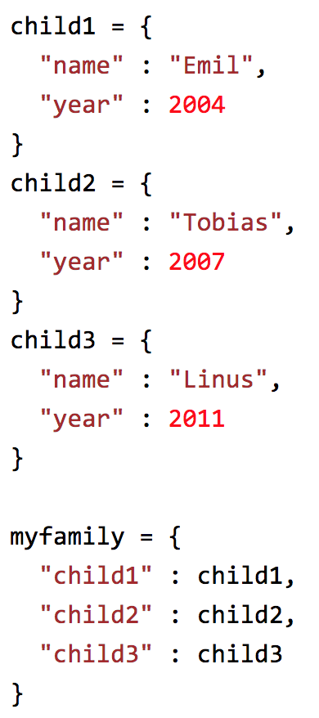
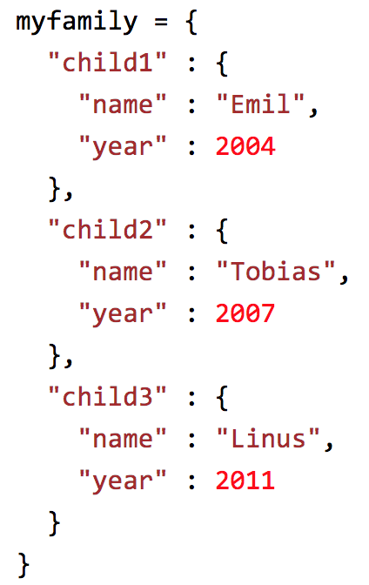
Dictionaries
Nested dictionaries are allowed and an important feature:

Slide 8
Dictionaries
To return the number of times a value appears in a list, use the count() method
fruit = ['apple', 'banana', 'cherry']
x = fruit.count("cherry") returns the number 1
The index() method returns the position at the first occurrence of the specified value
fruits = ['apple', 'banana', 'cherry']
x = fruits.index("cherry") returns the number 2
The reverse() method reverses the sorting order of the elements
fruit = ['apple', 'banana', 'cherry']
fruit.reverse()
The sort() method sorts the list ascending by default smallest to largest or alphabetically or specifying which order as an optional input
fruit = ['apple', 'banana', 'cherry']
fruit.sort(reverse=true)

